Slide 1



SQL
PROJECT
BY HEMAVARSHINE

Slide 2
PROJECT OVERVIEW
Pizza Hut Sales Analysis
Based on Number of ordered placed
Total Revenue Generated
Identifying most common Pizza ordered
Top 5 most Ordered pizzas
Percentage contribution of each pizza

Slide 3
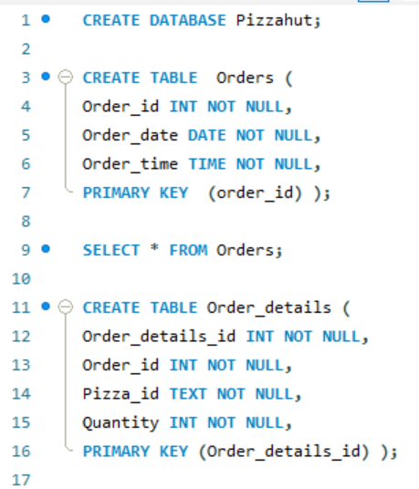
CREATING A DATABASE AND TABLES

Slide 4

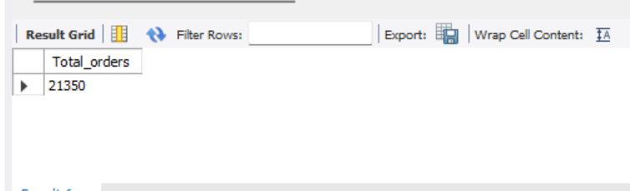
Retrieve Total Number of Order placed

Slide 5
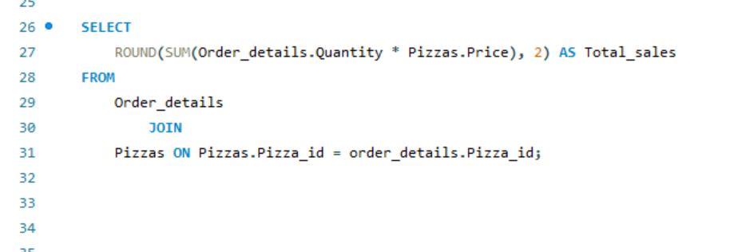
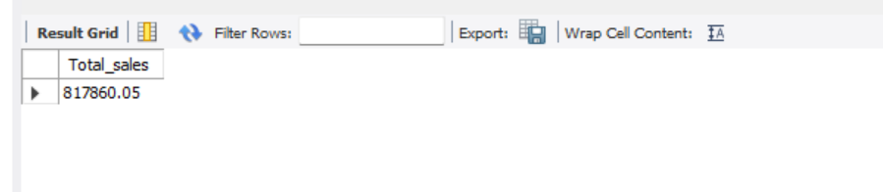
Calculate the Total Revenue generated from pizza sales

Slide 6
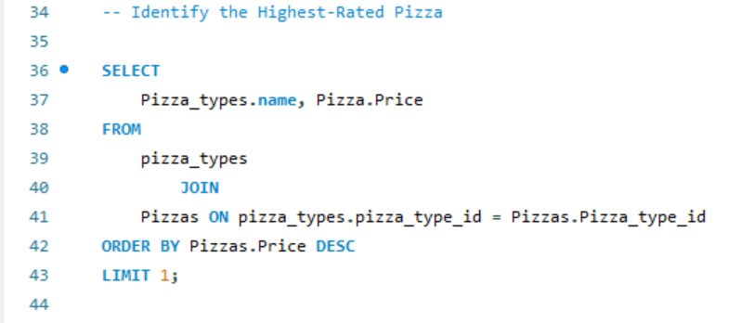
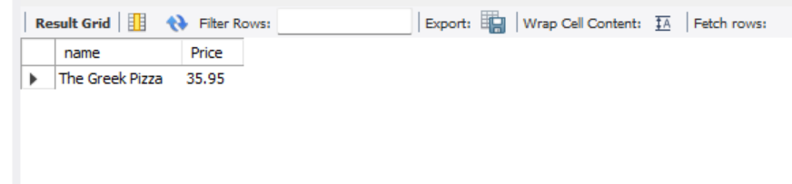
Identify the Highest-Rated Pizza

Slide 7
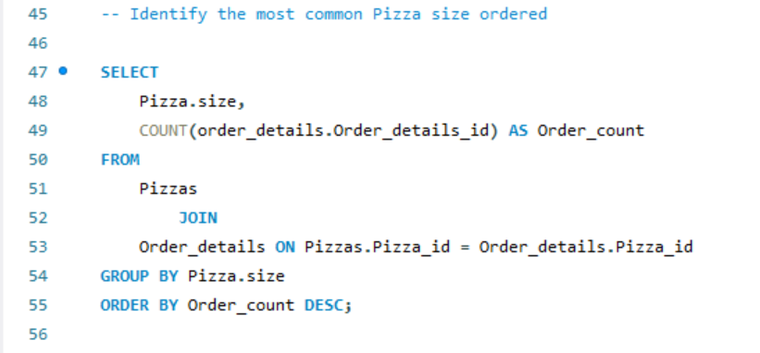
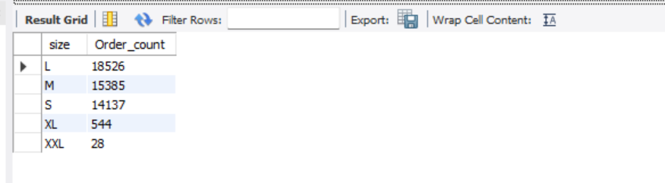
Identify the most common Pizza size ordered

Slide 8
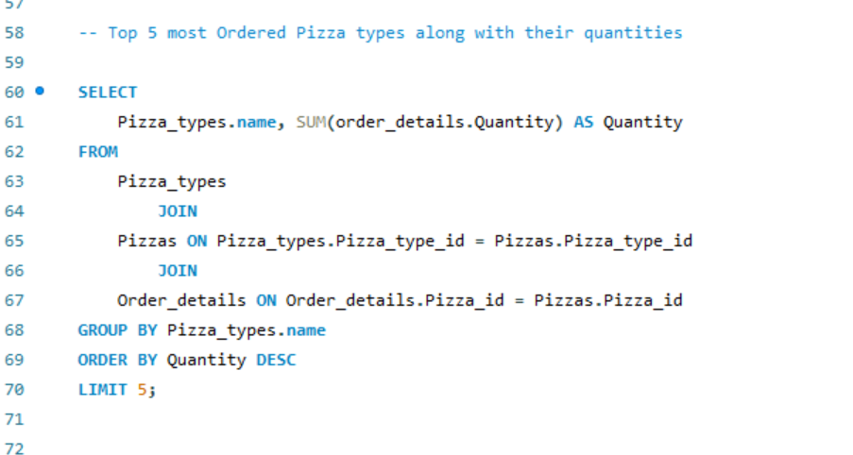
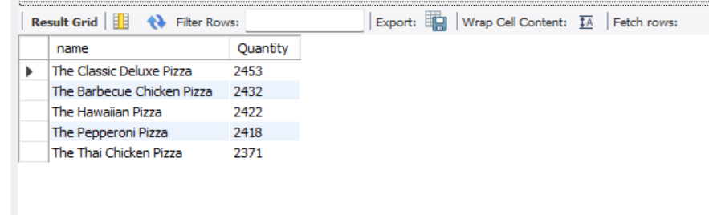
Top 5 most Ordered Pizza types along with their quantities

Slide 9
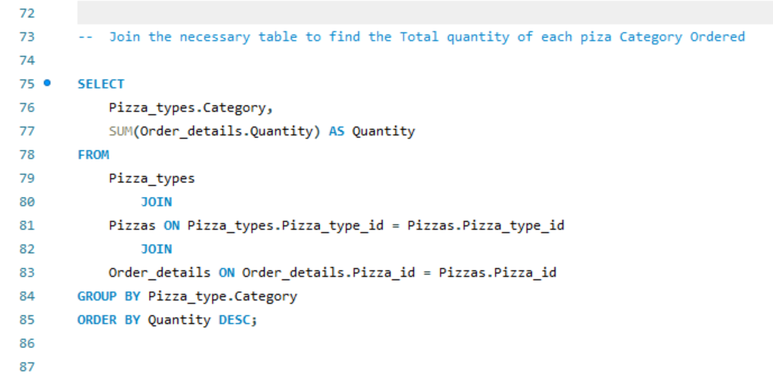
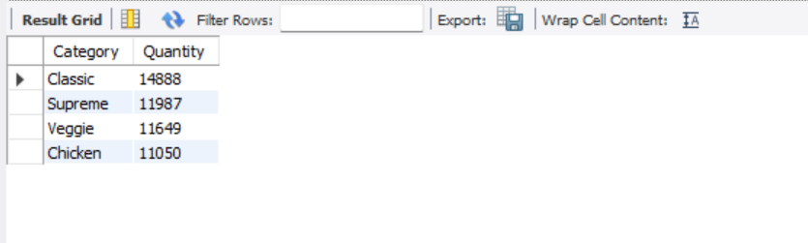
Join the necessary table to find the Total quantity of each piza Category Ordered

Slide 10
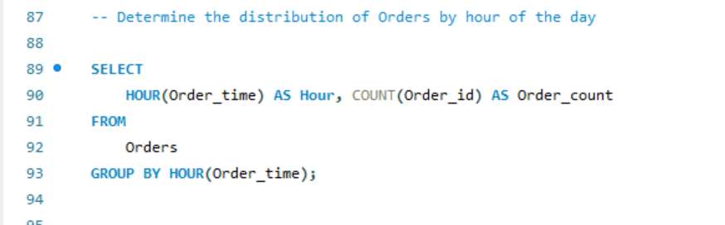
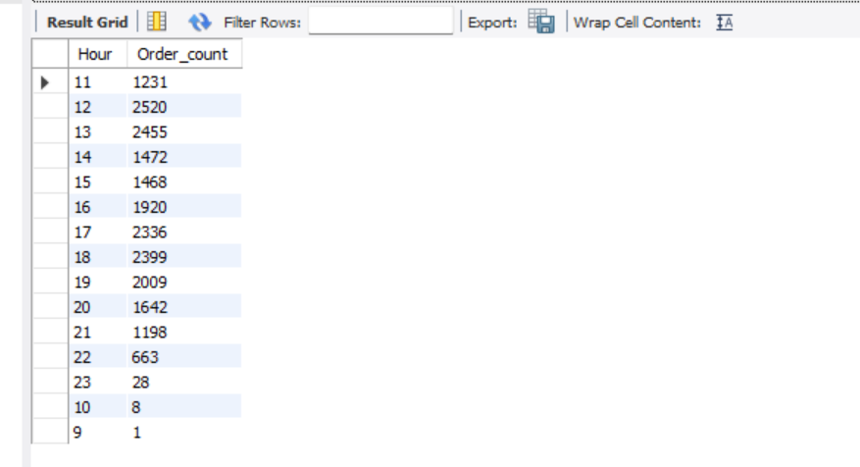
Determine the distribution of Orders by hour of the day

Slide 11
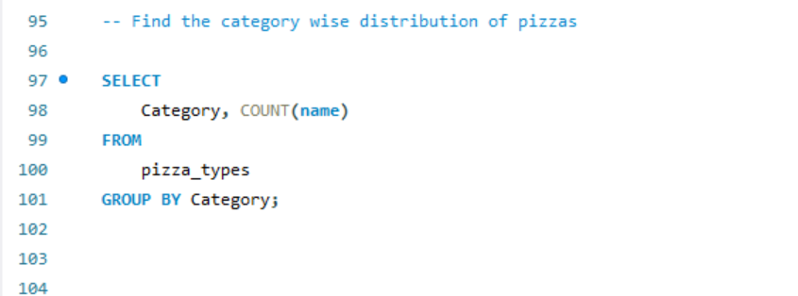
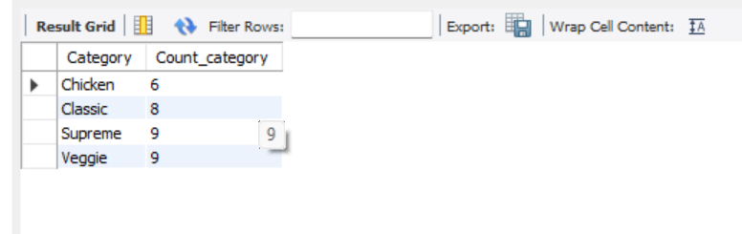
Find the category wise distribution of pizzas

Slide 12
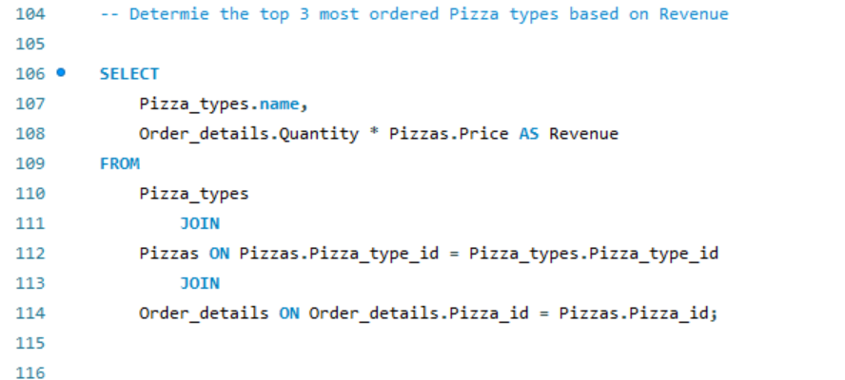
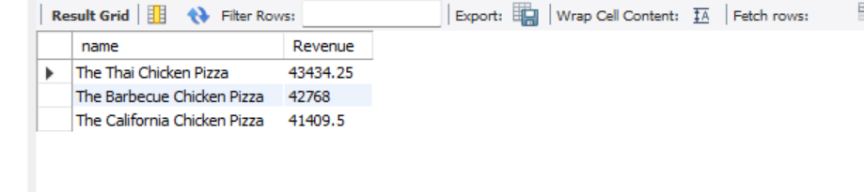
Determine the top 3 most ordered Pizza types based on Revenue

Slide 13
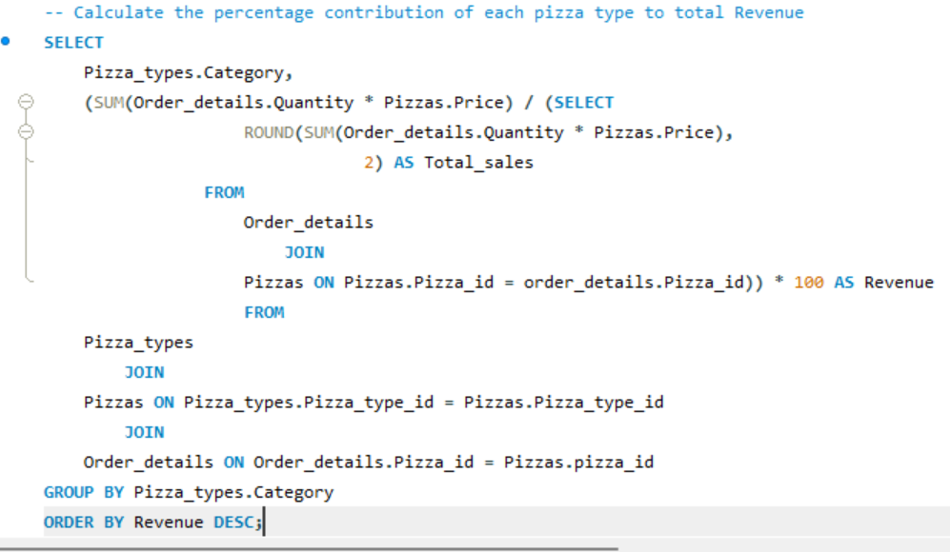
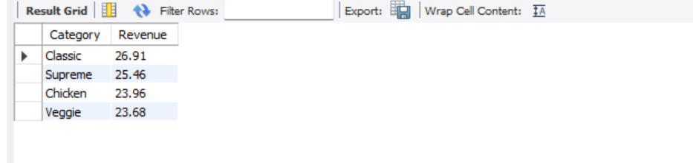
Calculate the percentage contribution of each pizza type to total Revenue

Slide 14
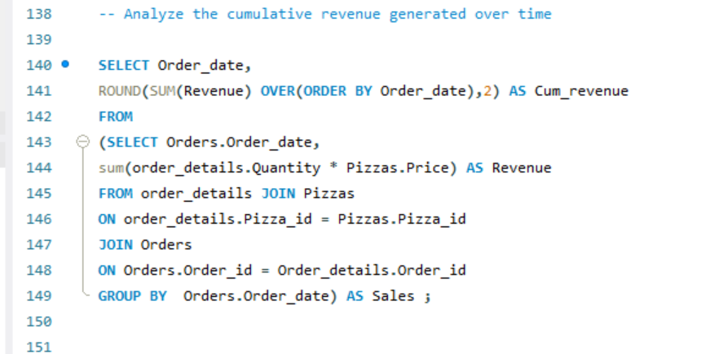
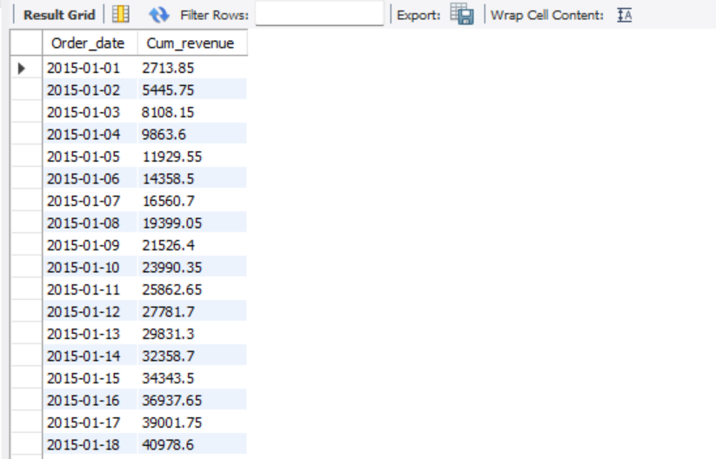
Analyze the cumulative revenue generated over time

Slide 15
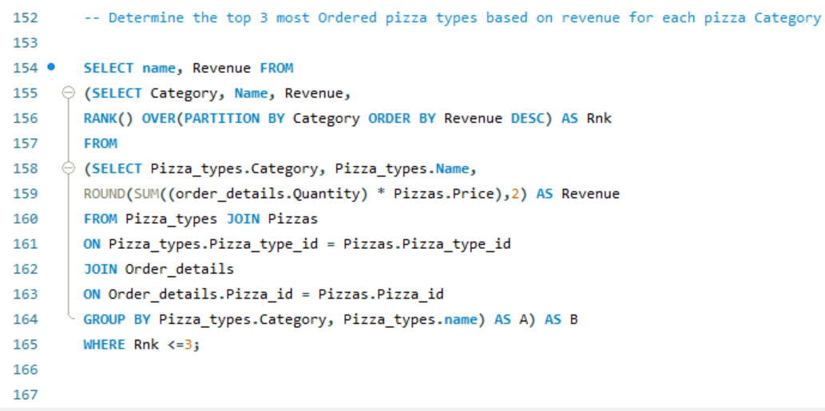
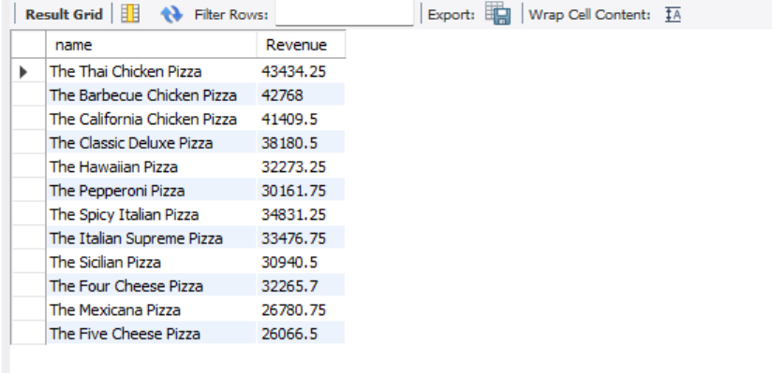
Determine the top 3 most Ordered pizza types based on revenue for each pizza Category

Slide 16



CONCLUSIONS
The analysis of Pizza Hut’s data using SQL highlighted the top-ordered pizzas and their percentage contributions to overall sales. By identifying the most popular menu items, I was able to determine which pizzas generate the most revenue.

Slide 17

THANK YOU

